Slide 1
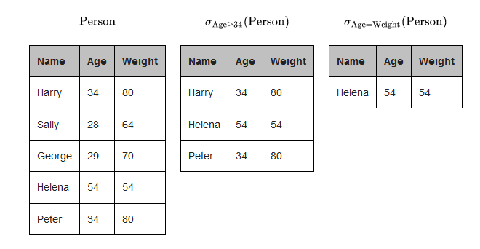
Relational Algebra
Procedural query language
Selection: a function that pulls data from a row associated with a given attribute (ex: all names from a database that are of a certain age)
Projection: pull columns from the database (ex: display the full list of employee IDs and names in this database)

Slide 2
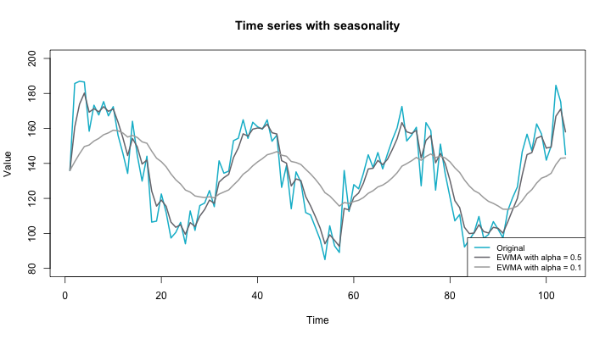
Exponential Smoothing
Like rolling averages, but not…
In a rolling average, all data points are equally weighted.
But in exponential smoothing, older data points are exponentially weighted less than more current observations.
Degree of smoothing dependent on the alpha value (smoothing factor)
Simple
Double: If trends present
Triple: If trends and seasonality present
Good for short-term predictions, but beware for the longer-term!

Slide 3
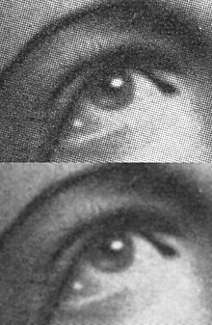
Gaussian or Median Filters
Frequently used in audio or visual noise reduction and smoothing
A Gaussian filter uses the named function (which also expresses the normal distribution in statistics) to calculate the transformation to apply to each data point. It is linear, and generally better at removing Gaussian noise (more evenly distributed).
A median filter uses the median of a certain number of a data point’s neighbors to do the same, and is non-linear. Because its output is definitively equal to one of the neighboring values, it is good for “edge detection”. It is also better at removing “salt and pepper” noise.

Slide 4
The Seduction of Imputation!
“The idea of imputation is both seductive and dangerous” (R.J.A Little & D.B. Rubin)
Types of Missing Data
Missing Completely at Random (MCAR): The fact that a certain value is missing has nothing to do with its hypothetical value and with the values of other variables.
Can delete, but at the risk of reducing sample size!
Missing at Random (MAR): Missing value is dependent on some other variable’s value (e.g. Let’s assume that females generally don’t want to reveal their ages!)
Impute, but beware to use the correct methodology!
Missing not at Random (MNAR): The value of the variable that's missing is related to the reason it's missing (e.g., people with high salaries generally do not want to reveal their incomes in surveys)
Challenging! Consider sensitivity analysis.

Slide 5
Mean Imputation
Steps:
Calculate the mean of the variable with missing observations and insert that mean into the missing values
Pros:
Reduces variance in the dataset
Does not change the sample mean
Cons:
Does not take into account relationships with other variables
Best Uses: Univariate datasets, MCAR situations

Slide 6
Other Methods for MCAR or Univariate
Hot-deck imputation: missing value was imputed from a randomly selected similar record
Cold-deck imputation: selects donors from another dataset
Statistical distribution: can be applied rather than the mean, if the data is not normally distributed

Slide 7
Regression Imputation
Steps:
Correlation matrix can identify several predictors of the variable with missing values
Best predictors are selected and used as independent variables in a regression equation. The variable with missing data is used as the dependent variable. Cases with complete data for the predictor variables are used to generate the regression equation; the equation is then used to predict missing values for incomplete cases.
In an iterative process, values for the missing variable are inserted and then all cases are used to predict the dependent variable. These steps are repeated until the values of the predicted values from one step to the next converge.
Pros
Takes into account relationships with other variables (better for MAR situations if factors influencing the missingness are included)
Cons
“Over-fits” and deflates standard error (can be somewhat corrected by using stochastic regression to add average regression variance to each imputation, but this still may not be enough)
Assumes linear relationships (if using linear regression)

Slide 8
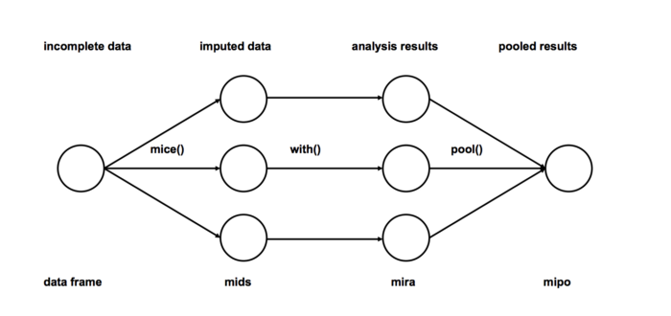
Markov Chain Monte Carlo Imputation
“Random” walks through high probability areas
Chains are generally developed starting from a set of points arbitrarily chosen and sufficiently distant from each other. These chains are stochastic processes of "walkers" which move around randomly according to an algorithm which looks for places with a reasonably high contribution to the integral to move into next, assigning them higher probabilities.
Best Use Case: High dimensional, non-monotonic data
Is one type of multiple imputation

